Slide 1
Getting Started with RavenDB
Jason Walker
Blackfin Technology

Slide 2
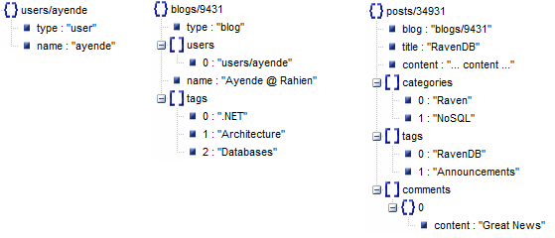
Document Database?

Slide 3
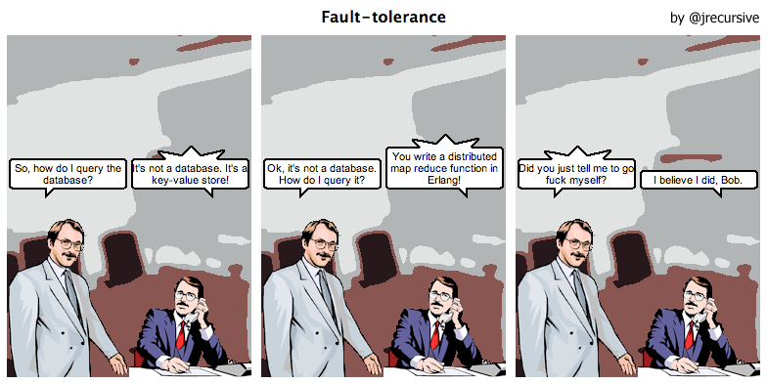
What RavenDB is NOT

Slide 4
What RavenDB is
In and for .NET
LINQ
Ad-hoc queries
Safe by default
Extensible
Fast
… and more.

Slide 5
References
http://groups.google.com/group/ravendb/
http://ravendb.net/
http://codeofrob.com/
jwalker@blackfin.com
http://onetrue.name/

